Slide 1
CREDIT CARD APPROVAL CLASSIFICATION
By Jesse Gempel
UNIVERSITY OF MISSOURI-ST. Louis
CMP SCI 4200-001

Slide 2
What is THE PROBLEM here?
Problem: is a customer creditworthy enough for a credit card?
GOAL: predict whether a client should be approved or rejected from receiving a credit card from a bank
Solution: implement binary classification in a model
  0 = customer is DENIED
  1= CUSTOMER IS APPROVED

Slide 3
Sources?
Two .csv files from Kaggle.com ^{[1]}
  APPLICATION DATA.csv —Stores customers’ information shared to bank from a completed application.
    18 Attributes (10 Predictors):
      ID, *Car ownership, *realty ownership, *yearly income, *income type, *EDUCATION TYPE, *FAMILY STATUS, *HOUSING TYPE, *age, *Days EMPLOYED, *OCCUPATION TYPE, Gender, children count, Mobile phone ownership, Work phone ownership, phone ownership, EMAIL, Family member count
  Credit data.csv —Stores monthly credit history for some of those customers.
    2 attributes (1 Predictor): ID, *Credit History Length
    1 Target: payment status
*Note: Bold font represents a predictor.

Slide 4
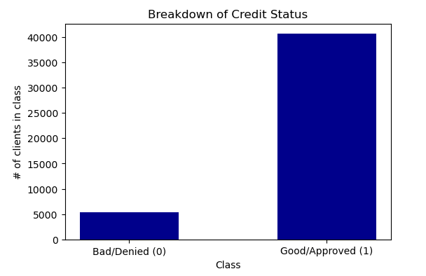
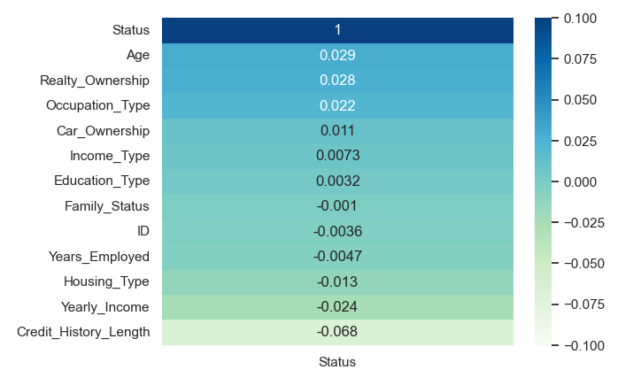
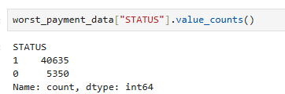
Figure 2: A heatmap illustrating the correlation between credit history status and the 11 predictors used (plus the ID).
Figure 1: (top) A bar plot illustrating the two classes of credit card clients. (bottom) A tabular view of the classes’ value counts. These classes will be used for a machine learning model to solve this binary classification problem.

Slide 5
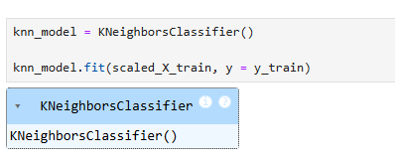
The Machine Learning Algorithm
Algorithm: k-neighbors Classifier
  Relationships between target (Creditworthiness) and predictors (over a dozen) are not linear.
  A supervised Learning Technique is required.
  K-neighbors classifier is simple yet effective.
Figure 3: Python implementation of a k-Neighbors Classifier model.

Slide 6

Setting up the model
Splitting the data
  70% Training Data, 30% Test data
Utilizing appropriate performance metrics
  F1-score (Benchmark of 0.80)
  Precision score (Benchmark of 0.85)
  Mean of stratified k-Fold Cross Validation score [2]

Slide 7


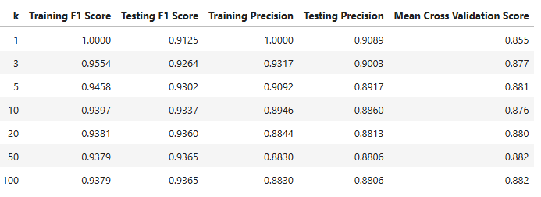
Results
K-NEIGHBORS CLASSIFIER (DEFAULT HYPERPARAMETERS)
K-NEIGHBORS CLASSIFIER (WHILE TUNING HYPERPARAMETERS)
Figure 4: Metric results after re-running the model seven additional times, once for each value of the k hyperparameter.

Slide 8
WHAT IS THE TAKE-HOME MESSAGE HERE?
My Model (k-neighbors Classifier)
  F1-score between 0.93 and 1.00 (surpasses 0.80 benchmark)
  Precision between 0.88 and 1.00 (surpasses 0.85 benchmark)
My source’s Models
  Logistic regression[3]
    F1-score of 0.75
    Precision of 0.75
  Random Forest Classifier[3]
    F1-score of 0.79
    Precision of 0.79

Slide 9
References
[1] Moneyman. (2020, March 24). Credit Card Approval Prediction [Data set]. Kaggle. Retrieved October 24, 2024, from https://www.kaggle.com/datasets/rikdifos/credit-card-approval-
[2] Stratified K Fold Cross Validation (2023, January 10). GeeksforGeeks. https://www.geeksforgeeks.org/stratified-k-fold-cross-validation/#
[3] Hіколайченко, I. (2024, October 16). Credit_Card_Approval_Prediction [Jupyter Notebook] Kaggle. Retrieved October 24, 2024, from https://www. kaggle.com/code/frotfl1pp/credit-card-approval-prediction

